Slide 1


Slide 2


AUTOMATIC WORKING WINDOW
TEAM MEMBERS
GUIDED BY
Mrs.P.SAKTHI
SOBIYA .T(927621BEC205)
SUJITHA.V(927621BEC222)
SHOBIKA.S(927621BEC198)

Slide 3
INTRODUCTION
The report is about designing an auto close window device which changes the discomforts associated with normal residential or commercial window method for a long period of time and even now people still go towards the window to shut down when the rain .

Slide 4
COMPONENTS REQUIRED
Arduino
GSM module
Rain Sensor
Servo Motor

Slide 5
ABSTRACT
It focuses on using rain sensor, and it can be used in both everyday life and manufacturing. The ultimate goal of this project is to detect rain using a rain sensor. Everyone's life revolves around water. It will close the window when it rains and prevent the rain water entering into house. It also helps to minimize the damage caused by the rain water. When the rain detector senses rain, it closes the window.

Slide 6
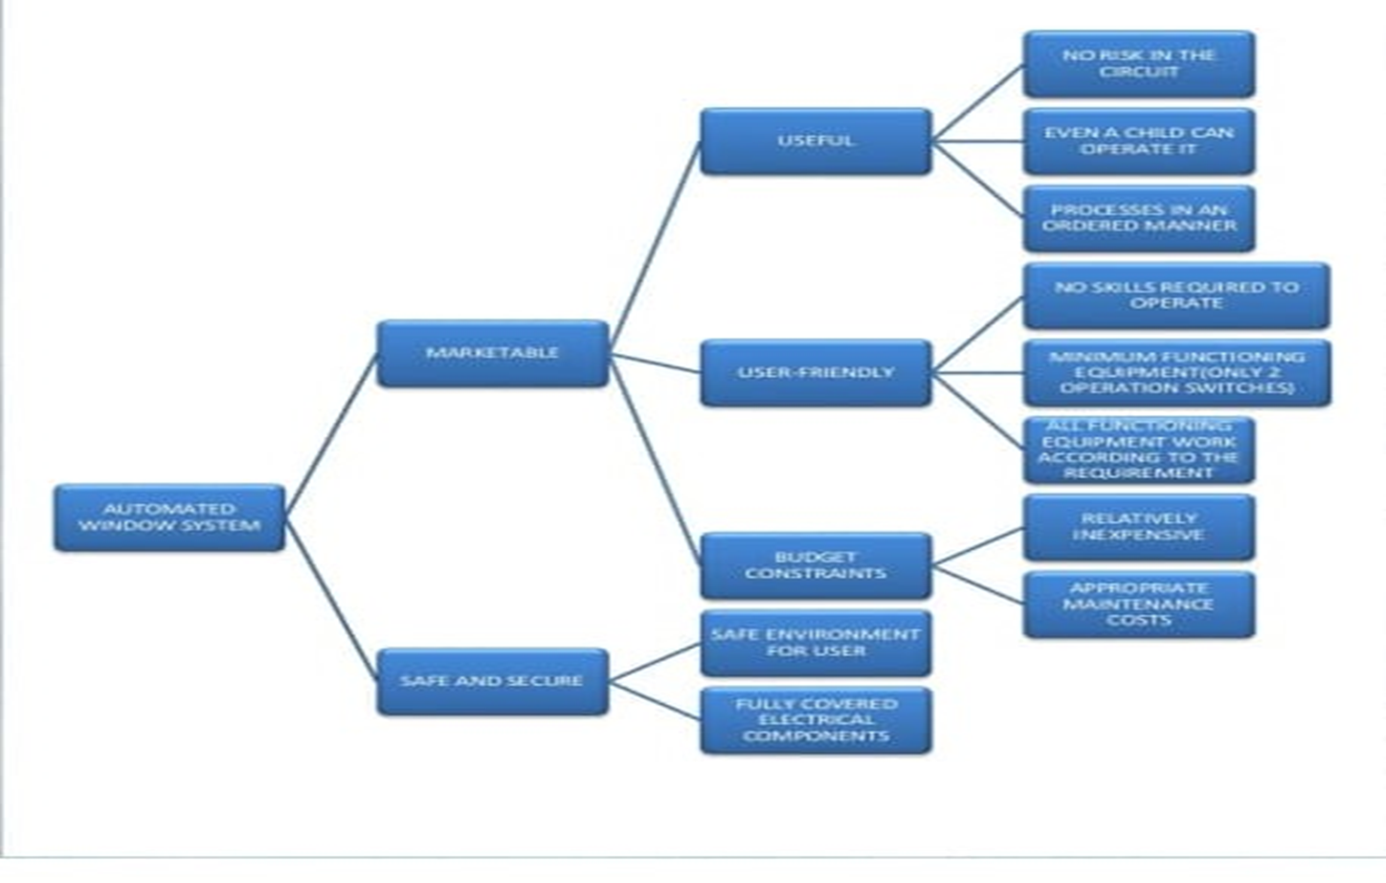
BLOCK DIAGRAM :

Slide 7
ADVANTAGES :
Operating principle is vary easy
It consumes less power for operation
Installation of rain sensor based systems are very much simple
Individual rain sensor costs very less

Slide 8
COST ANALYSIS :
PRICE OF MATERIAL USED:
Aluminum-RS.900/=per 1 inch box bar
PRICES OF THE PARTS USED :
12V DC gear motor 120 RPM –RS.1000/=
Rack pinion –RS.1000/=
Gear pinion –RS.300/=
PCB and electrical components –RS.600/=
8 pin riley-RS.200/=
Copper board and components -300/=
Circuits covering box –RS.100/=
LABOUR COST :
Aluminium worker-RS.600/=
Lathe worker –RS.500/=
Electrical worker-RS.300/=

Slide 9
PROBLEMS :
Energy wastage
Have to worry about close windows when it’s raining
Small children damage themselves trying to close higher windows

Slide 10
Conclusion :
To conclude that the rain detector can be used in both residential and commercial settings. It alerts users to the presence of rainfall and rain when it is forecasted to fall. It is activated by even the tiniest drop of water, allowing the user plenty of time to reclaim their belongings, cover windows, and in some situations .

Slide 11


